Slide 1
Application Programming Interface
Module Project
Module: Application Programming Interface
Start Date : 12 December 2022
End Date : 11 January 2023
Submission Date : January 2023
Learner Name : Wildan Luqmanul Hakim
Enrollment ID : BDSE04-0322/STTB
Presentation Date :

Slide 2
Contents
Contents
S. No. | Description
01 | List of Tools used
02 | What is API?
03 | What is the role of API?
04 | The range of APIs for a particular platform
05 | Potential Security issues with API
06 | The project requirements
07 | Project Demo
08 | The Strengths of Project API
09 | The Weakness of Project API
10 | Security Report

Slide 3
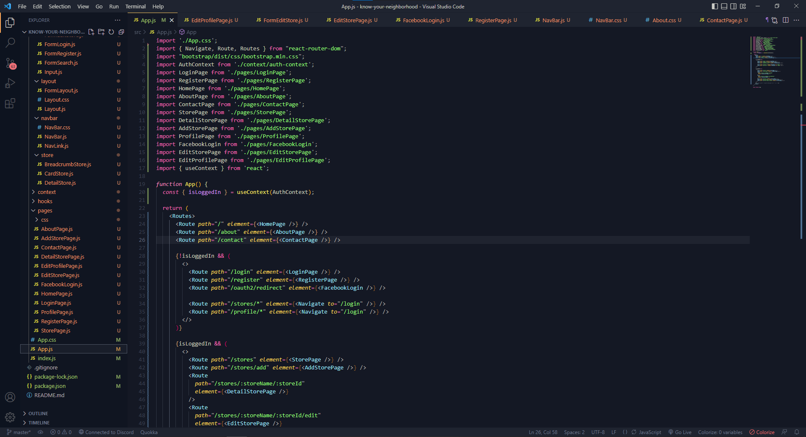
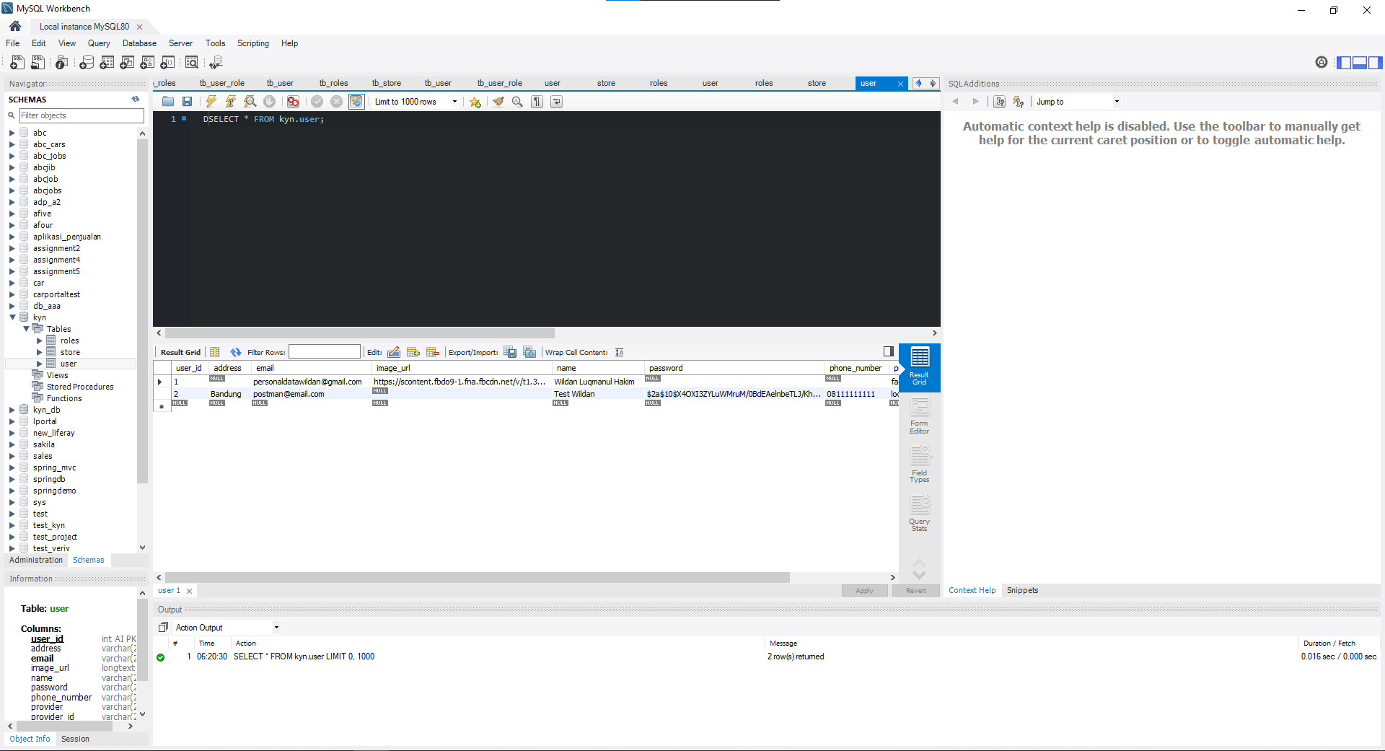
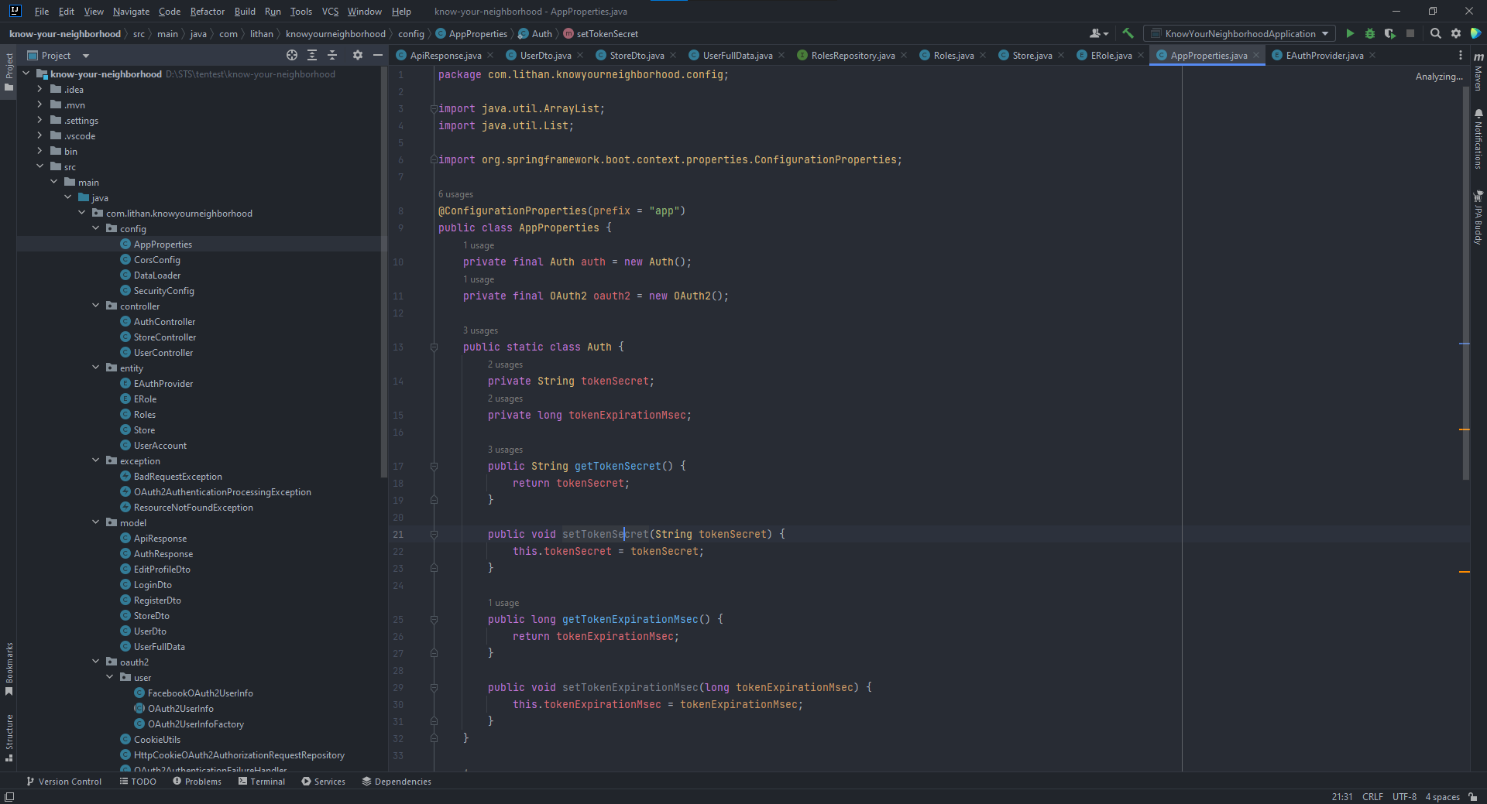
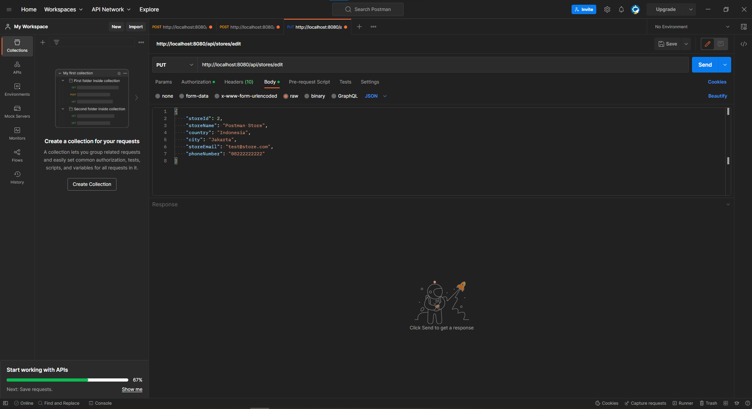
1. List of Tools used
Visual Studio Code
MySQL
IntellIj IDEA
Postman

Slide 4
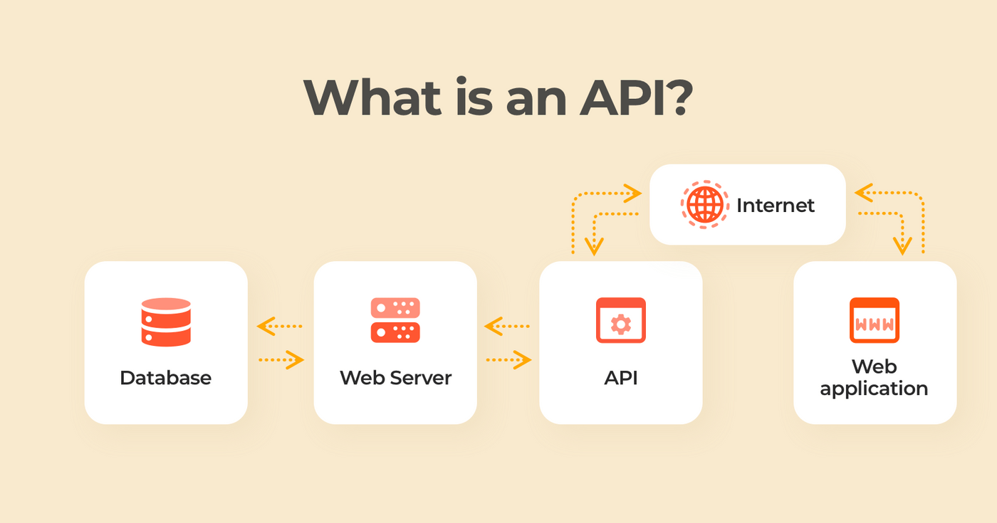
2. What is API?
Application Programming Interface (API). It is a system of guidelines, procedures, and building blocks for software and applications.

Slide 5
3. What is the role of API?
A set of guidelines and protocols for communication between various software systems is what an API (Application Programming Interface) is there to do. It makes it possible for various systems to share information and functionality in a consistent and controlled way. Among the typical functions of an API are:
Integration
Access to functionality
Reusability

Slide 6
4. The range of APIs for a particular platform
.
The selection of APIs that are offered for a given platform is determined by the features that platform can support as well as the requirements of the developers who use it.
For instance, a well-known platform like iOS has a large selection of APIs that include both third-party APIs like Alamofire, SwiftyJSON, and Kingfisher as well as official APIs like UIKit, Core Location, and Core Data.

Slide 7
5. Potential Security Issues with APIs
Injection attacks
Data leakage
Authentication and access control
Lack of rate limiting
Weak or compromised keys

Slide 8
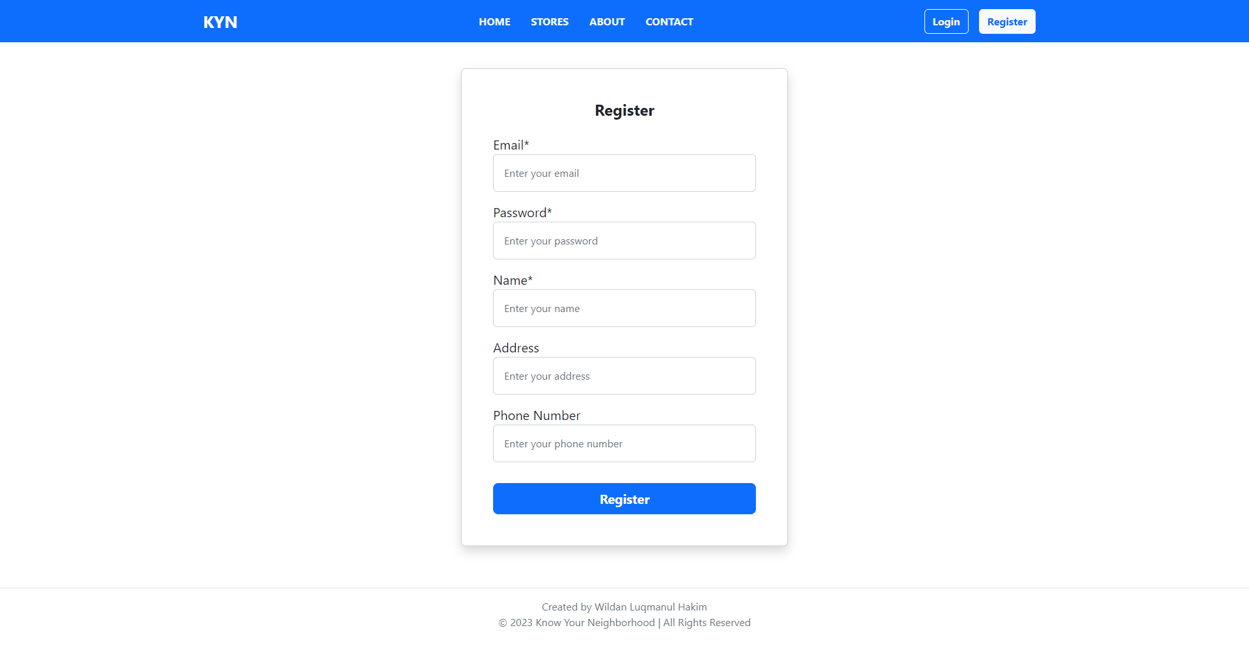
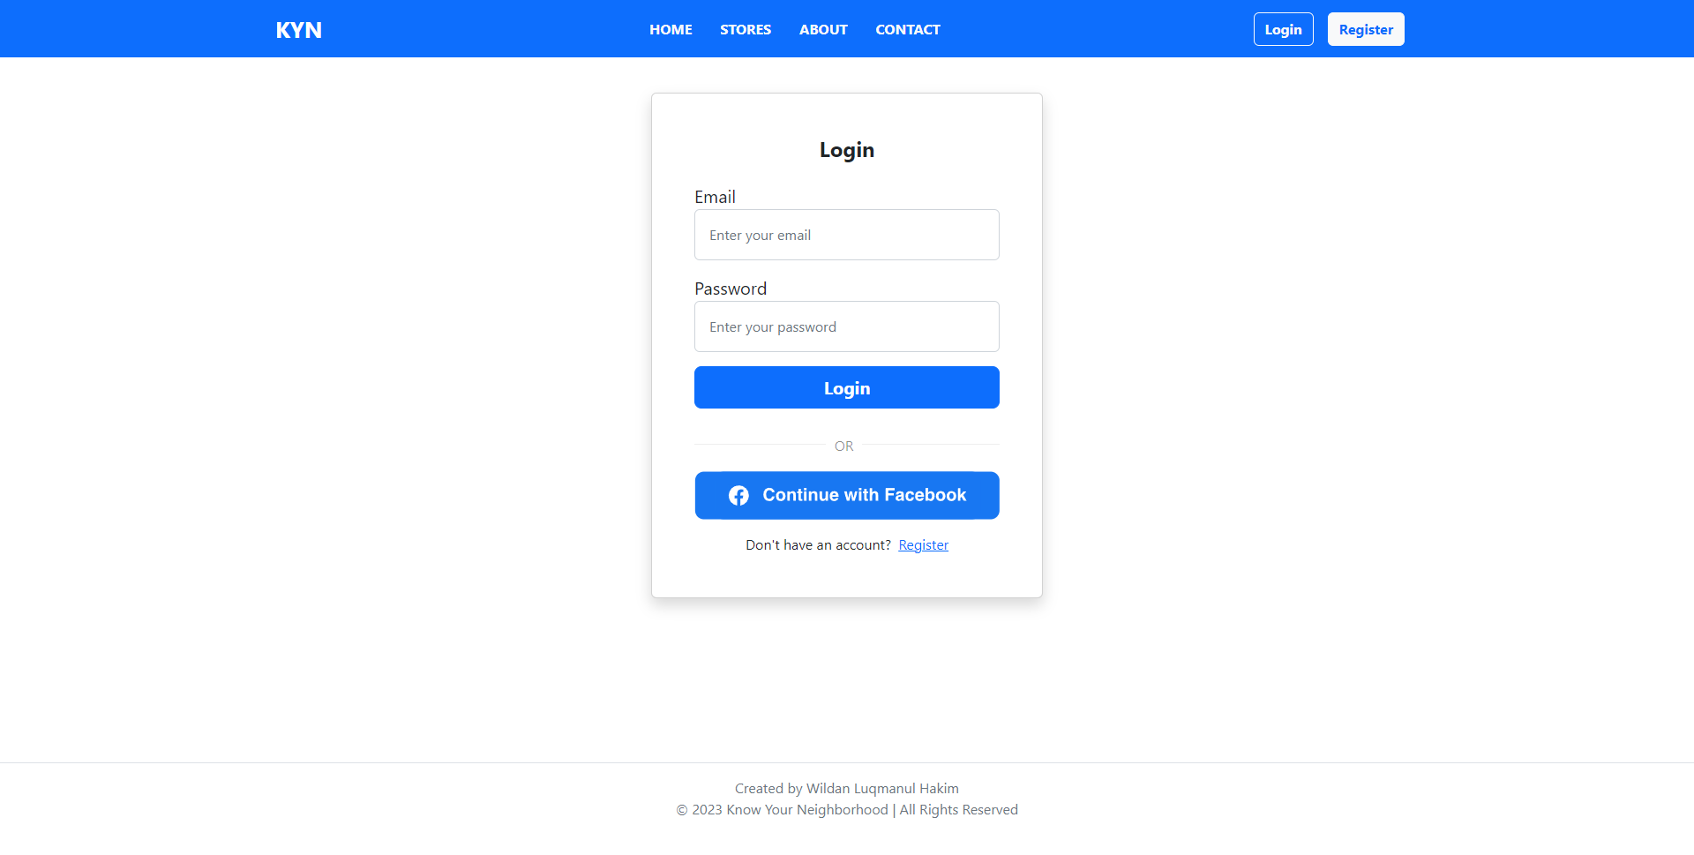
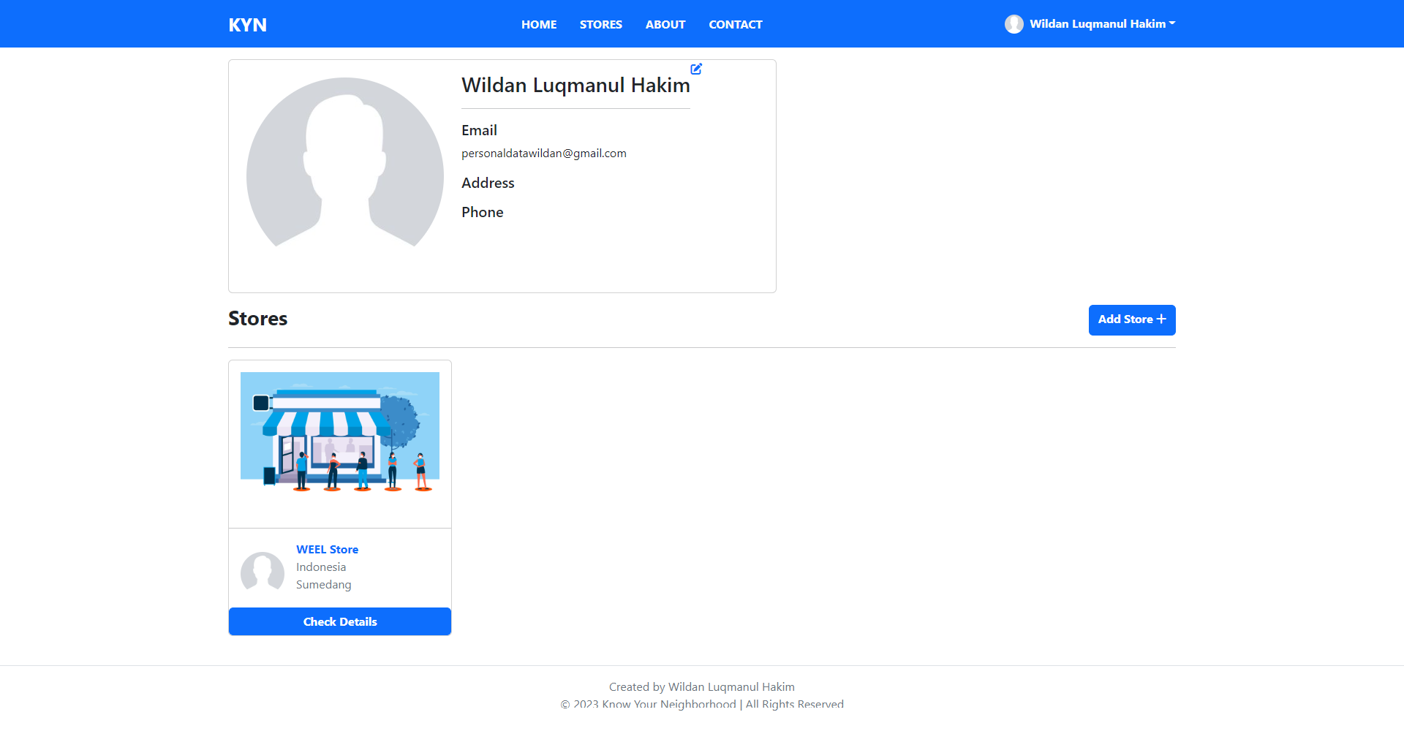
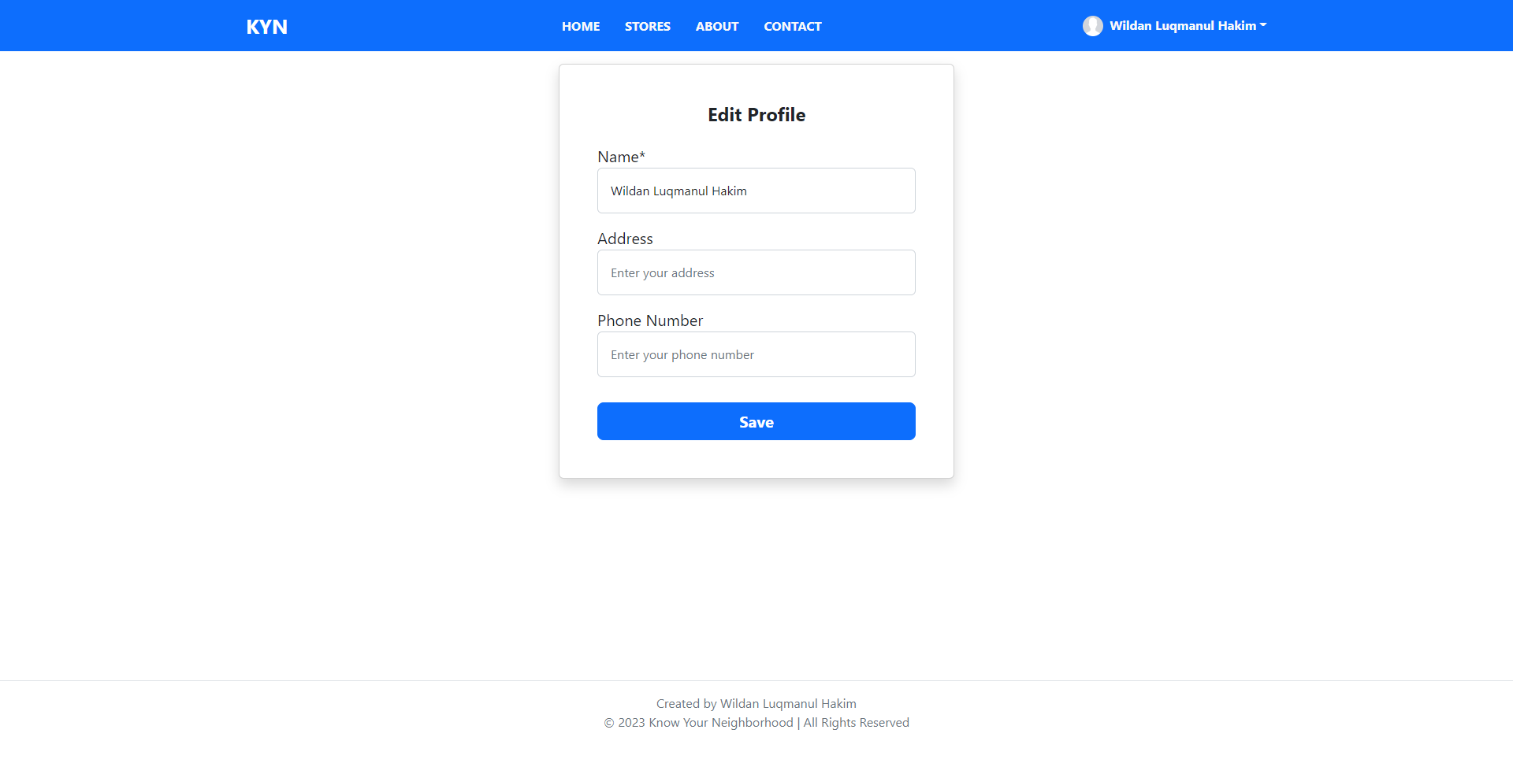
6. The Project Demo
Register Page
Login Page
Profile Page
Edit Profile Page
Edit Profile Page

Slide 9
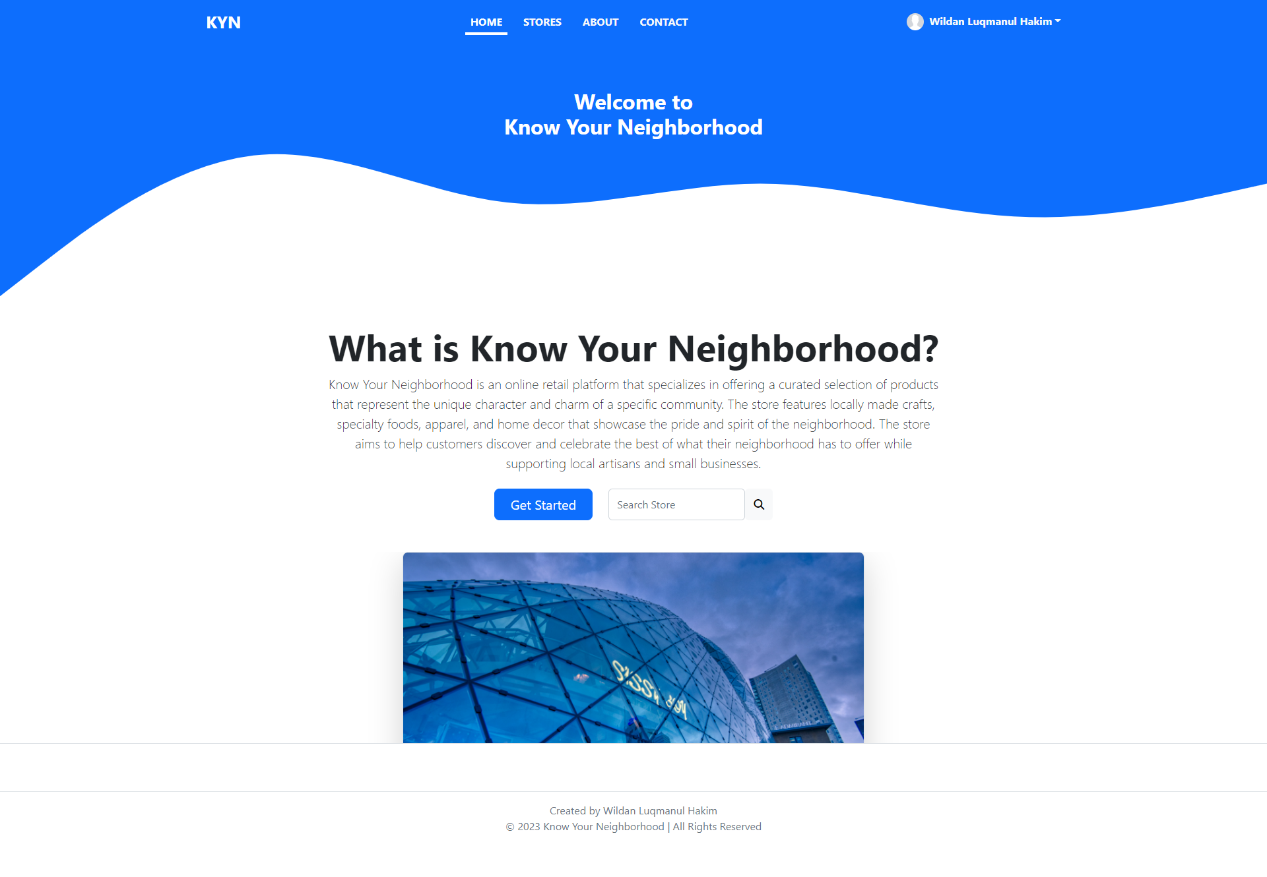
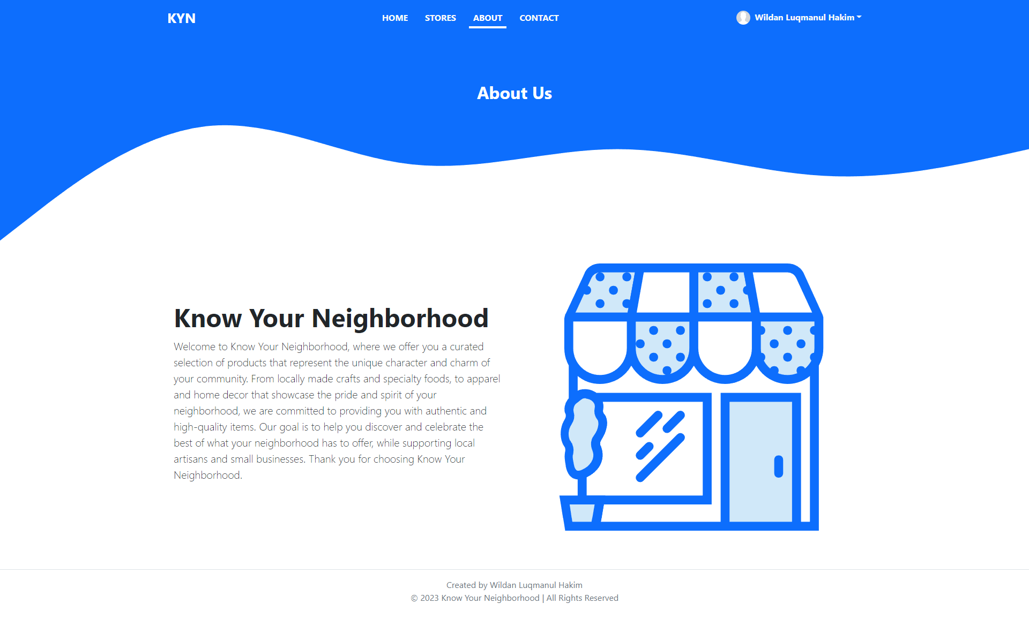
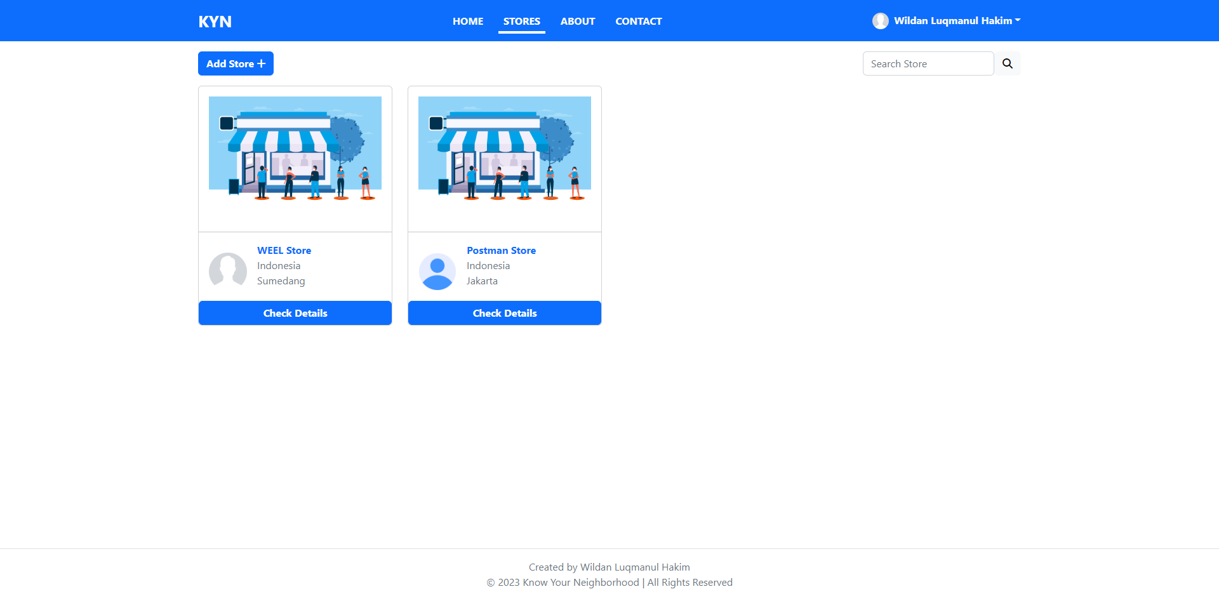
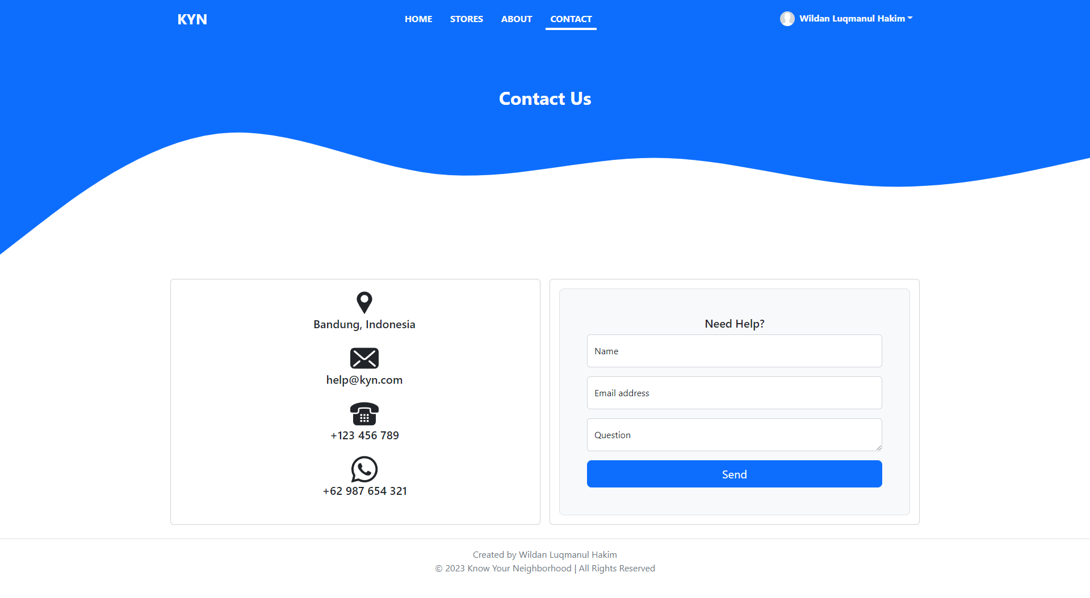
6. The Project Demo
Home Page
About Us Page
Stores Page
Contact Us Page

Slide 10
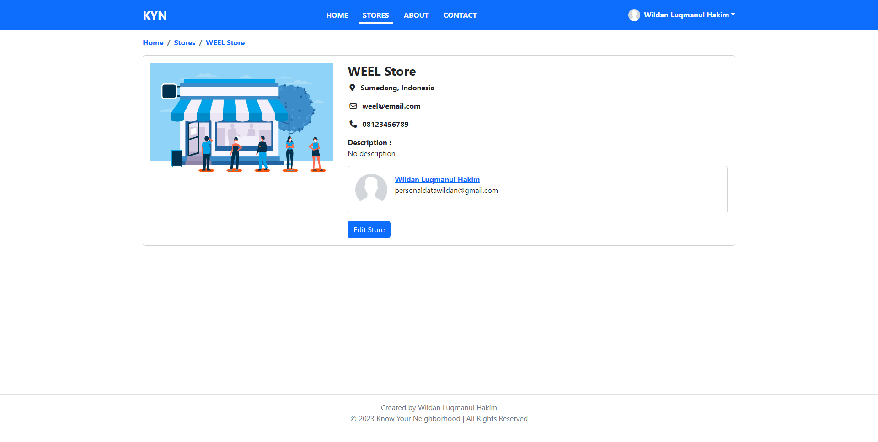
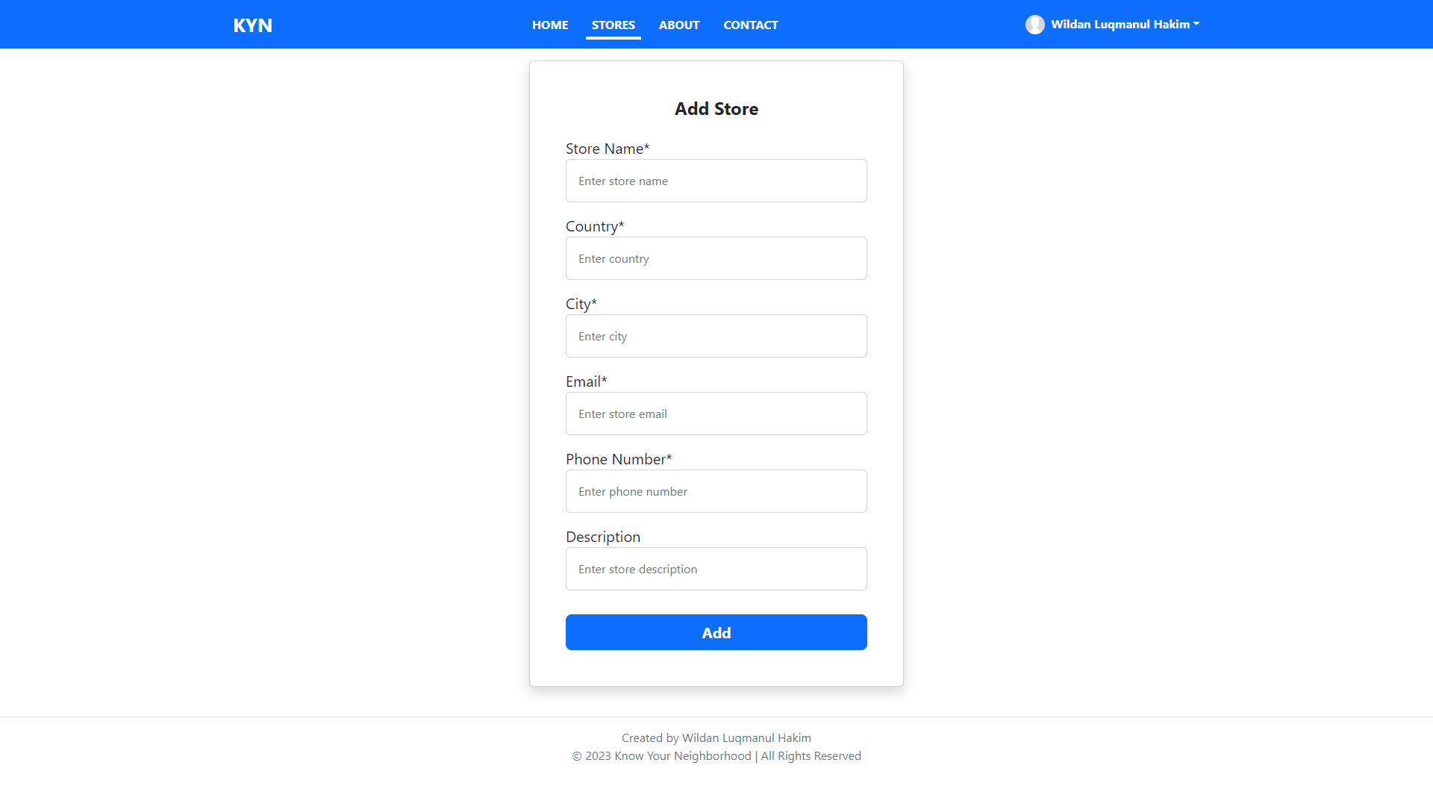

6. The Project Demo
Detail Store Page
Add Store Page
Edit Store Page

Slide 11
7. The Strengths of Project API
A wide range of developers can use them because they are easy to use and comprehend.
Since they transmit data using HTTP standard methods (such as GET, POST, PUT, and DELETE), they are simple to integrate with other tools and systems.
Because of their light weight, they can be used with a variety of networks and devices.
They don't require the maintenance of sessions or connections because they are stateless, which means that each request can stand on its own.
Because of their platform independence, they work with a wide range of frameworks and programming languages.

Slide 12
8. The Weaknesses of Project API
They can be less secure than other types of APIs, as they rely on the underlying transport protocol (HTTP) to provide security.
They can be prone to errors if not implemented properly, as they rely on clients to provide correct input.
They can be less efficient than other types of APIs, as they require additional overhead (e.g. parsing JSON or XML) to process data.
Some use cases may require more complex features than REST can provide.

Slide 13
9. Security Report
Spring Security
Security with OAuth
Authentication with JWT

